Slide 1

La Lumiere Fine Dining
PRESENTED BY:

Slide 2
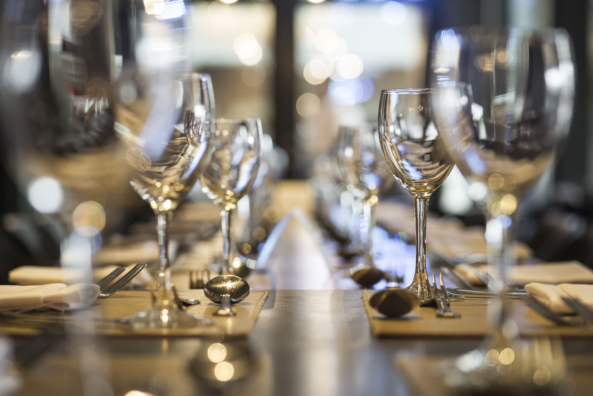
La Lumiere Fine Dining Overviews
La Lumiere fine Dining offers a luxurious and contemporary dining experience blending French culinary artistry with South African influences. The restaurants features a multi-course tasting menu, seasonal ingredients, and an award-winning wine selection .

Slide 3
La Lumiere Fine Dining Challenges
Hard to track customer's orders leading to repeating orders
No online booking option
Costly to scale operations
Mix-ups of orders

Slide 4

AWS services
Amazon S3 ( Simple Storage Services)

Slide 5
Cost analysis
AWS Lambda
S3
AWS Dynamo DB

Slide 6
Benefits of migrating to AWS
Reduces booking and orders errors through automated online processes
Provides scalability as customers demand grows
It is cost-efficient : pay for only storage used
Enhance customers satisfaction with faster , more reliable services

